Slide 1
CHAPTER FIVE
UNSTEADY STATE CONDUCTION

Slide 2
Lumped-heat-capacity system
The convection heat loss from the body is evidenced as a decrease in the internal energy of the body, as shown in Figure (1). Thus
$$q=hA\left(T−T_{a}\right)=−ρ cp V \frac{dT}{dτ}……….1$$
$$\frac{\left(T\left(τ\right)−T_{a}\right)}{\left({Ti−T}_{a}\right)}=exp\left[\frac{−hAτ}{ρc_{p}V}\right]……..2$$
$\frac{ρc_{p}V}{hA}=t$ its known as time constant and has a unit of time
$$\frac{\left(T\left(τ\right)−T_{a}\right)}{\left({Ti−T}_{a}\right)}=exp\left[\frac{−τ}{t}\right]$$

Slide 3
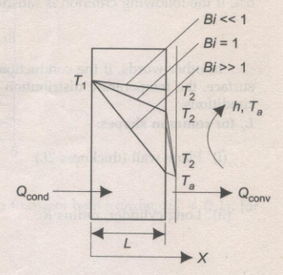
Criteria for lumped system analysis (Biot number and Fourier number)
Let the surface on the left be maintained at temperature T₁ and the surface on the right is at a temperature of T₂ as a result of heat being lost to a fluid at temperature T_{a}, flowing with a heat transfer coefficient h. Writing an energy balance at the right hand surface.
$$\frac{k.A}{L}.\left(T_{1}−T_{2}\right)=h.A.\left(T_{2}−T_{a}\right)$$
Rearranging
$$\frac{\left(T_{1}−T_{2}\right)}{\left(T_{2}−T_{a}\right)}=\frac{\frac{L}{kA}}{\frac{1}{hA}}=\frac{R_{cond}}{R_{conv}}=\frac{hL}{k}=Bi$$
the term, (h.L)/k, is a dimensionless number, known as
Biot number. Biot number is a measure of
the temperature drop in the solid relative
to the temperature drop in the convective layer

Slide 4
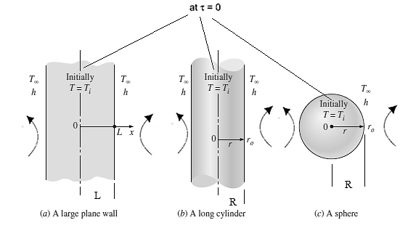
One-dimensional transient conduction in large plane walls, long cylinders and spheres when Biot number > 0.1
$$\frac{d^{2}T}{dx^{2}}=\frac{1}{α}\frac{∂T}{∂τ}$$
$$\frac{dT}{dx^{ }}=0 at x=0, for τ>0$$
$$−k\frac{dT}{dx^{ }}=h.\left(T−T_{a}\right) at x=L, for τ>0$$
$$T_{i}=T for τ=0, in 0<x<L$$

Slide 5
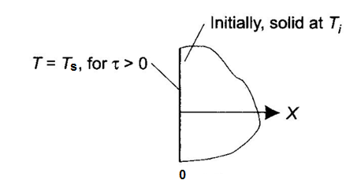
5.4 Transient Heat Flow In A Semi-Infinite Solid
See Fig. 4. The solid is initially at a uniform temperature T_{i} and for times $τ$ > 0, the boundary surface at x= 0 is maintained at temperature T_{s}. Starting with the differential Eq. for one-dimensional, time dependent conduction, for these boundary conditions, the non-dimensional temperature distribution (solved by the Laplace-transform technique) in the solid is obtained
as:
$$\frac{T\left(x,τ\right)−Ts}{Ti−Ts}=erf\frac{x}{2\sqrt{ατ}}………………..3$$
where the Gauss error function $\left\{(erf(ζ)\right\}$ is tabulated in table 1
$$so: ζ=\frac{x}{2\sqrt{ατ}} and, erf\left(ζ\right)=\frac{T\left(x,τ\right)−Ts}{Ti−Ts}$$
Total heat flow during $τ=0$ to $τ=τ$
$$Q_{total}=1.13.k.A\left(To−Ti\right).\sqrt{\frac{τ}{α}} J$$

